Slide 1





Lakeside Farms Map
2026-2027
MP Room
Shelter
S1-Mansour
S2-Cullen
S3-Ehlers
Under MPR
STAFF PARKING LOT
OFFICE
Attendance
Victor
Copy Art Room Room
Secretary
Browning
P12
Library
Kemsley
P13
TK
Speedie
P14
TK
Curtis
P15
TK
Brizuela
P16
TK
Weitz
12
RSP
Health
Jones
TK
LOUNGE
Principal
Rosa
10
Day
19
SDC
DeLyser
9
Kiziroglou
18
Root
PLAYGROUND
8
RSP
Kitchen/ Cafeteria
7
Brannon
17
Samples
6
Brown
16
Purgason
P11
Anderson
P10
Rhodes
Field
Lunch Tables
C
Gutzmer
5
Lawler
15
Bojorquez
P7
SDC
Garcia
P8
SDC Cormode
P9
Summy
B
Lowry
4
Wickman
14
Fletcher
A
Winter
Speech
OT
SPED
P2
Bathroom
3
Hober
13
Street
P6
Radcliff
K1
Andrews
K2
Jones
P1
Parker
OLD ESS
P3
Morehouse
P4
Frazer
P5
Flynn
Kinder Playground
BUS LINE

Slide 2

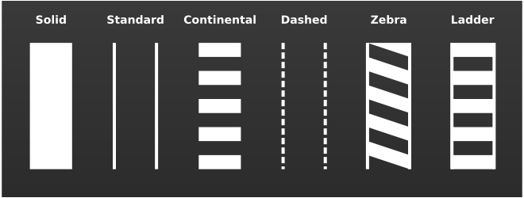
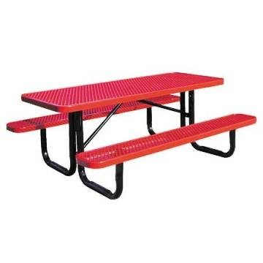










LAKESIDE FARMS COUGARS ARE RESPONSIBLE, SAFE, and RESPECTFUL
(Enter)
Lakeside Avenue
Lakeside Farms Map
2025-2026
PARKING LOT
(Exit) Riverside Drive
PARENT WAITING AREA
Side gate will be locked during morning drop off & dismissal- no student entry or exit
STUDENT WAITING AREA

